Slide 1
Classification and regression trees
Alejandro Ordonez
Assistant Professor - Department of Bioscience
Section for Ecoinformatics & Biodiversity
Center for Biodiversity Dynamics in a Changing World (BIOCHANGE)

Slide 2
Classification What we will talk about today
Classification as a regression – Using data to constrain the clustering
Clarification and Regression trees (CART)– Use a single tree to generate perditions.
Random Forests (RF)– Use many trees and bagging techniques to improve predictions.
Boosted Regression Trees(RF)– Use many trees and boosting techniques to improve predictions.

Slide 3
Any questions?
Ready to start?

Slide 4
TREE MODELS
These are…
computationally intensive methods based on the recursive partition of the response variable based on the information contained in the predictors.
Yes
No
Yes
No
Yes
No
Yes
No
Yes
No

Slide 5
WHY USE TREE MODELS?
They are simple to interpret
Great for initial data inspection.
Give a very clear picture of the structure of the data.
Provide a highly intuitive insight into the kinds of interactions between variables.
Require little to no data preparation.
Great to handle non-linearities.
But they are black boxes
we know that a variable has an effect but not what is the effect

Slide 6
PARTS OF A TREE MODEL
Root
Splits
Leaf's

Slide 7
So far so good?
Any questions?
Ready to move on?

Slide 8
(MULTIVARIATE) REGRESSION TREES
Alternative non-linear /non-parametric models to describe how a response variable changes as a function of a set of continuous/categorical predictors.
These approaches are particularly useful when the data has lots of features which interact in complicated, nonlinear ways.
Regression trees are analogous to multiple regression models in the context that they use multiple predictors variables to generate a prediction.

Slide 9
(MULTIVARIATE) REGRESSION TREES
The computation of a (M)RT consists in two procedures running together:
Constrained partitioning of the data:
Divining the response variables into yes or no conditions based on the predictors using a binary recursive partitioning approach.
Cross-validation of the results:
Assess how good is the split using a subset of the dataset to assess the deviance or the cross-validated relative error as “quality” criteria.

Slide 10
(MULTIVARIATE) REGRESSION TREES
What is binary recursive partitioning?
Split in two and keep the solution that minimises the within group variability
This is done until all objects form their own group or until a preselected smallest number of objects per group is reached.
Second-split
First-split

Slide 11
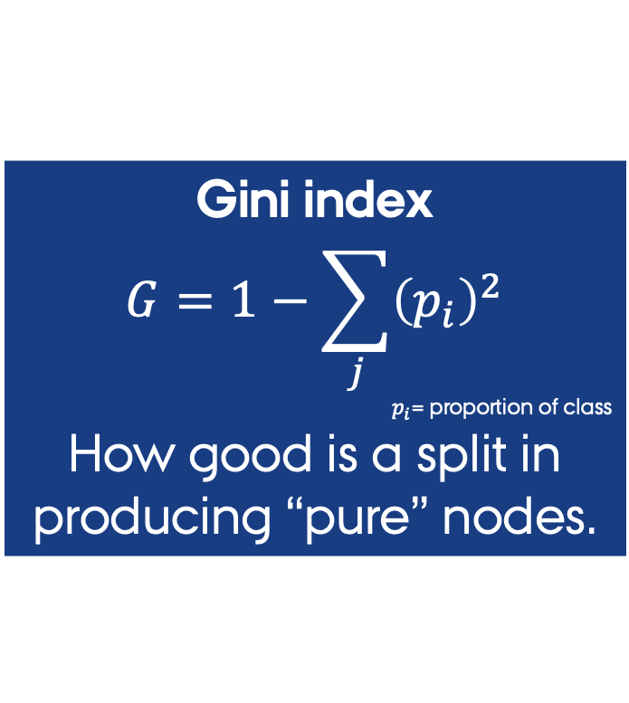
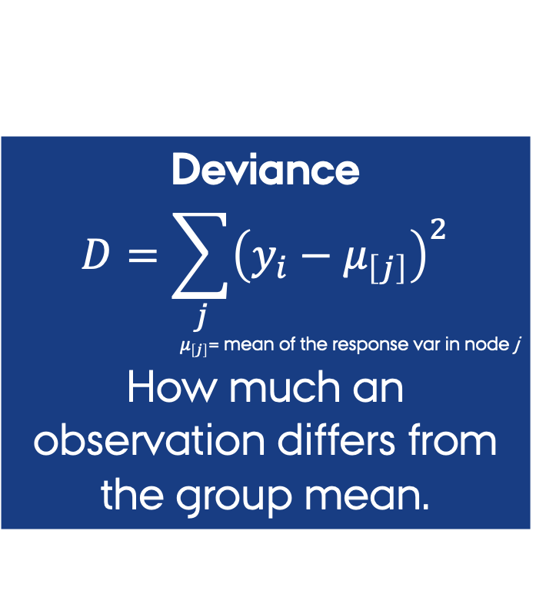
(MULTIVARIATE) REGRESSION TREES
Splits are based on a measure of “purity”
purity = node contains observations primarily from a single class or similar values.
Deviance
$$D=\sum_{j}{{\left(y_{i}−μ_{\left[j\right]}\right)}^{2}}$$
$μ_{\left[j\right]}$= mean of the response var in node j
How much an observation differs from the group mean.
Gini index
$$G=1−\sum_{j}{{\left(p_{i}\right)}^{2}}$$
$p_{i}$= proportion of class
How good is a split in producing “pure” nodes.

Slide 12
(MULTIVARIATE) REGRESSION TREES
The split procedure takes place until nodes contain only one set of features, or the data are too sparse (fewer than six cases).
Second-split
First-split

Slide 13
Regression/classification TREES
As for linear regression, Regression trees produce a predictive model that can be used in other datasets.
Like a regression we have two aims
Simplicity (few nodes).
Maximising the explained variance in the response variable.

Slide 14
Regression/classification TREES
As for any regression, you define the additive combination of predictors (X₁,…X_{n}) &
the response , that can be
Categorical OR Continuous
fit <- rpart(Y ~ X₁ + X₂ + X₃ , method="anova", data=DataIn)

Slide 15
Regression/classification TREES
Defines the type of data you have
"class" for a classification tree "anova" for a regression tree
you should ALWAYS specify this argument
fit <- rpart(Y ~ X₁ + X₂ + X₃ , method="anova", data=DataIn)
classification tree = Categorical response
regression tree = Numerical response

Slide 16
So far so good?
Any questions?
Ready to move on?

Slide 17
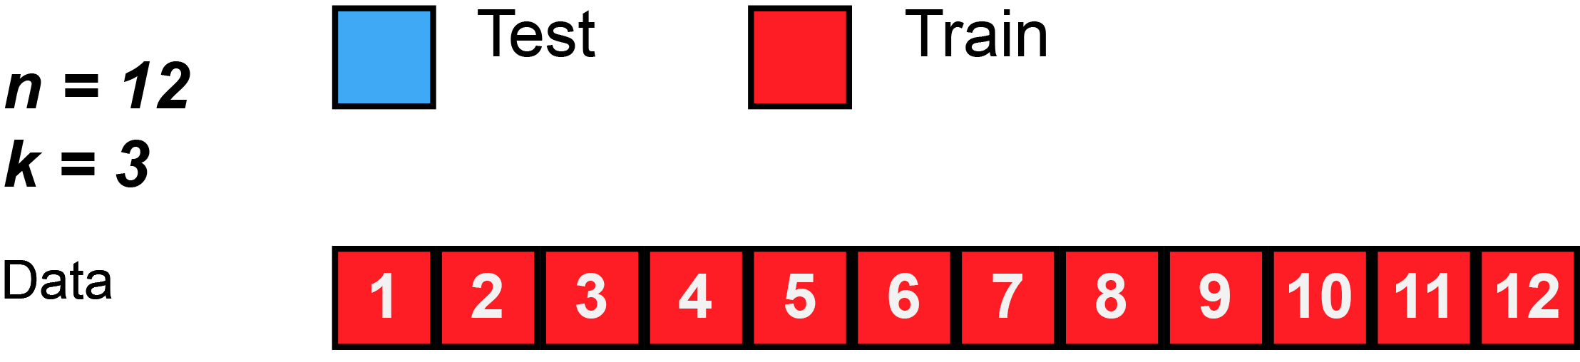
Regression/classification TREES CROSS-VALIDATION
What is cross-validation? → a way to assess model fil by dividing the data into two sets
Training → used to build a model (usually 70% of the observations)
Testing → used to assess the “goodness-of-fit” of the regression tree (the remaining 30%))

Slide 18
Regression/classification TREES CROSS-VALIDATION
What is cross-validation? → a way to assess model fil by dividing the data into two sets
Training → used to build a model (usually 70% of the observations)
Testing → used to assess the “goodness-of-fit” of the regression tree (the remaining 30%))
The goal is to build multiple trees with different training datasets to assess model performance

Slide 19
Regression/classification TREES CROSS-VALIDATION
How good is your classification
How often you make an error
cross-validation error
cross-validation fit
Apparent = Observed
Cross validated = x relative

Slide 20
So far so good?
Any questions?
Ready to move on?

Slide 21
Regression/classification TREES SIMPLIFICATION
Model simplification in the context of regression trees focuses on deciding how much of a model to retain (number of splits) by balancing:
Cross-validation values → how good is my model
Complexity parameter → cost of adding another variable/node to the model.
This is an analogue philosophy to stepwise selection where you add/remove variables and testing how much is gained/lost by doing so.

Slide 22
Regression/classification TREES SIMPLIFICATION
Number of terminal leaf's
Based on a cost–complexity measure
At which point adding a nodes does not improve the model.
Do we need more than 3 leaf’s?
The 1-SE rule
Value of cp before the curve becomes flat.
Cross-validation error
Complexity parameter

Slide 23
Regression/classification TREES SIMPLIFICATION
Number of terminal leaf's
Typically, you will want to select a Complexity parameter (hence tree size) that minimizes the cross-validated error.
Optimizes the trade-off between fit and explanatory power.
Value of cp before the curve becomes flat.
Cross-validation error
Complexity parameter

Slide 24
Regression/classification TREES SIMPLIFICATION
An alternative criteria is based on assessing the change in the Cross-validation error
printcp(fit)
Regression tree:
rpart(formula = Mileage ~ Price + Country + Reliability + Type,
data = cu.summary, method = "anova")
Variables actually used in tree construction:
[1] Price Type
Root node error: 1354.6/60 = 22.576
n=60 (57 observations deleted due to missingness)
CP nsplit rel error xerror xstd
1 0.622885 0 1.00000 1.04671 0.182034
2 0.132061 1 0.37711 0.51528 0.100760
3 0.025441 2 0.24505 0.35924 0.077717
4 0.011604 3 0.21961 0.34653 0.079250
5 0.010000 4 0.20801 0.36266 0.077115
Cross-validated error
At this level the error reaches the minimum

Slide 25
Regression/classification TREES SIMPLIFICATION

Slide 26
So far so good?
Any questions?
Ready to move on?

Slide 27
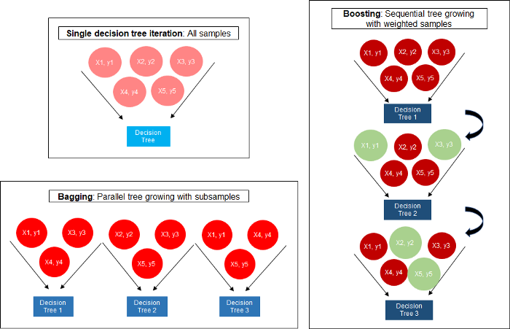
Radom Forests A generalized view of the algorithm
Radom Forests combine the strengths of two algorithms:
Regression trees: models that relate a response to their predictors by recursive binary splits
Bagging: an adaptive method for parallel tree growing with subsamples.

Slide 28
Random Forests
An assembly of multiple regression trees
Many trees are produced based on subsamples of the data [this is bagging!]
Each case is classified using each tree in this new "forest” of trees
A final predicted outcome is defined by combining the results across all the trees based on predefined criteria
Average in regression.
Majority vote in classification.
GOAL: Instead of searching for the most important feature while splitting a node, it searches for the best feature among a random subset of features.

Slide 29
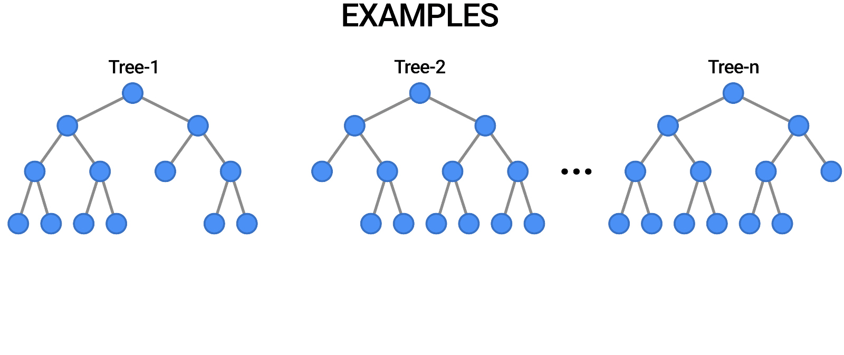
Random Forests

Slide 30
Random Forests Why (NOT) use these?
Advantages
Can be used with a variety of response types (binomial, gaussian, poisson).
Stochastic, which improves predictive performance.
It provides higher accuracy through cross validation.
Robust to missing values and outliers.
Can handle a large data sets with higher dimensionality.
Limitations
Sensitive to differences in the prevalence of each evaluated class.
Data and computational intensive:
You need many observations.
You need many trees.
Random Forests will struggle to make accurate predictions when:
The data are very spars.
There are not clear cut boundaries.
Sensitive to model parameters.

Slide 31
Random forests What do I Need to specify IT?
RF have five important parameters that need to be specified by the user.
Number of trees to generate: this defines on how many trees does my consensus prediction is based on.
How many predictors per tree: define how many predictors are used in the classification of each randomly sampled dataset.
Sample size: this defined how big of should be the sample of the original dataset.
Node size: minimum number of samples left in a node before a split.
Maximum number of nodes: Maximum depth of trees.

Slide 32
Random forests What do I Need to specify IT?
The important parameters that need to be specified by the user.
Number of trees to generate: this defines on how many trees does my consensus prediction is based on.
How many predictors per tree: define how many predictors are used in the classification of each randomly sampled dataset.
Sample size: this defined how big of should be the sample of the original dataset.
These are the set of parameters you will usually will like to start “adjusting” to optimise the prediction

Slide 33
Random Forests Implementing these in R
Basic implementation via the randomForest package
randomForest(formula, → a formula describing the model.
data, → Data frame with all the data.
ntree, → Number of random trees to generate.
mtry, → Number of predictors used in each tree .
importance) → Assess the predictors importance.
Some advanced arguments
sampsize → Size of the Random sample.
nodesize → Minimum number of samples left in the final leaf node.
maxnodes → Maximum depth of trees.
replace → If samples should be bootstrapped with replacement.

Slide 34
Random Forests – importance
Implemented via the randomForest package
library(randomForest)
fit <- randomForest(Mileage~.,
data= na.omit(cu.summary),
importance=TRUE)
importance(fit) # importance of each predictor
%IncMSE IncNodePurity
Price 20.179096 411.07061
Country 3.750334 109.71086
Reliability 4.076656 93.61005
Type 16.732901 299.68206

Slide 35
Random Forests – importance
varImpPlot(fit)# plot the importance of each predictor
%IncMS mean squared error increase if a variable is removed from the predictors
IncNodePurity increase in node impurity (how well the trees split the data) averaged over all trees

Slide 36
So far so good?
Any questions?
Ready to move on?

Slide 37
Boosted regression trees (BRT)
These models combine the strengths of two algorithms:
Regression trees: models that relate a response to their predictors by recursive binary splits
Boosting: an adaptive method for combining many simple models to give improved predictive performance.

Slide 38
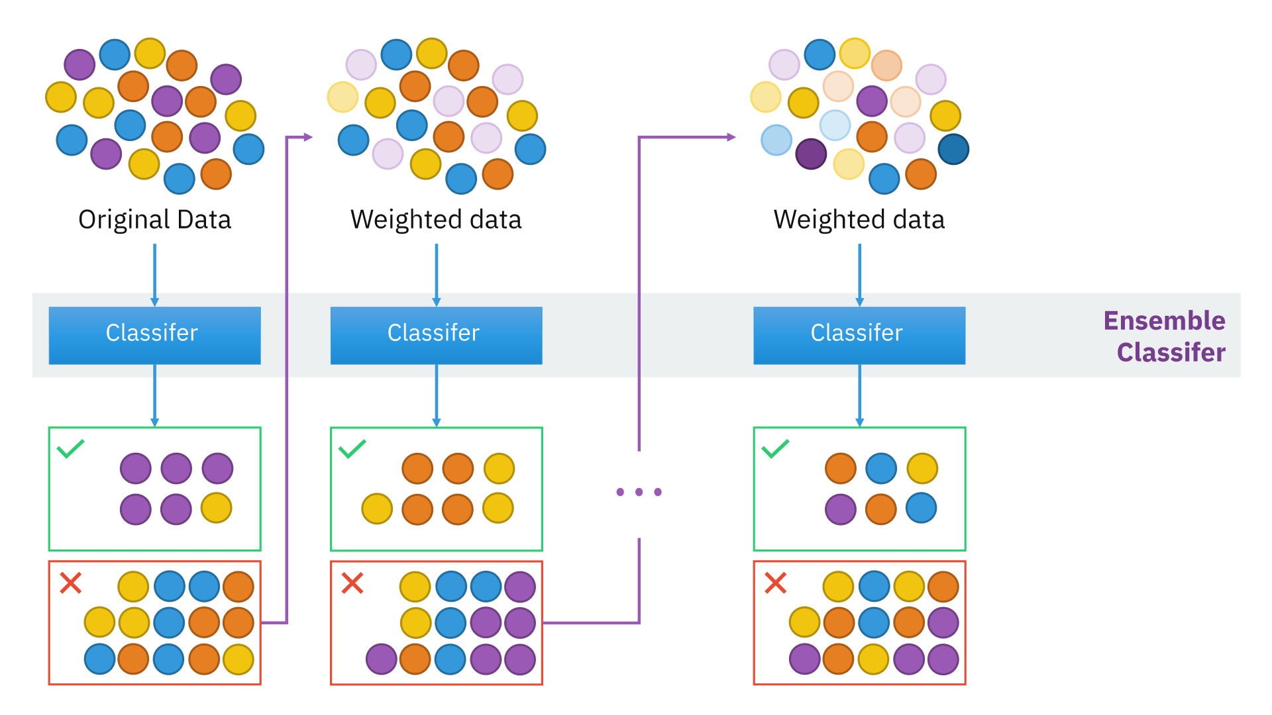
Boosted regression trees (BRT)
An assembly of sequential regression trees
Many SMALL trees are produced based on subsamples of the data.
But trees are built sequentially focusing on correcting past errors.
A final predicted outcome is defined by weighting the results across all the trees.
Weighted average in regression.
Weighted classification.
GOAL: Build many small trees (week learners) that when combined make a good calcification by correcting past mistakes .

Slide 39
Boosted regression trees (BRT)
What is the principle behind the approach?
Repeatedly fit many decision trees to improve the accuracy of the model.
The repetitions are based on random subsets (with replacement) have the same number of data points and are selected from the complete dataset.

Slide 40
Boosted regression trees (BRT)
What is the difference with Random forest?
In BRT, the random subsalting is weighted by the results of the trees build before.
This is boosting → subsequent models aim to correct the “error” of previous models.
After the first tree is fitted the model will consider the error in the prediction of that tree to fit the next tree (upweight those observation wrongly classified before), and so on.

Slide 41
Boosted regression trees (BRT) Why (NOT) use these?
Advantages
Can be used with a variety of response types (binomial, gaussian, poisson).
Stochastic, which improves predictive performance.
The best fit is automatically detected by the algorithm.
No need for data pre-processing
Model represents the effect of each predictor after accounting for the effects of other predictors.
Robust to missing values and outliers
Limitations
Needs at least 2 predictor variables to run.
Data and computational intensive:
you need many observations.
You need many trees.
Sensitive to model specifications.
Raw output are less interpretable.
Can overemphasize outliers.

Slide 42
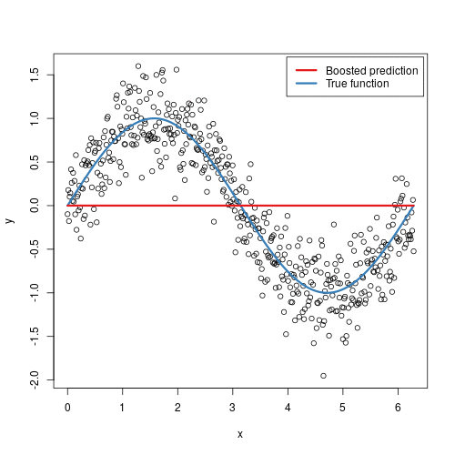
Boosted regression trees (BRT) A generalized view of the algorithm
The final BRT is simply a stagewise additive model of n individual regression trees
You start with a poor model that is improved sequentially…
and ends up with a series of trees that get get close to the true underlying pattern.
This is similar to basis functions in GAMs

Slide 43
Boosted regression trees (BRT) What do I Need to specify IT?
BRT have three important parameters that need to be specified by the user.
Bag fraction: this defined how big of should be the sample of the original dataset.
Tree complexity: this controls the number of splits in each tree.
Learning rate: this determines the contribution of each tree to the growing model.

Slide 44
Boosted regression trees (BRT) What Do I Need to specify IT?
The important parameters that need to be specified by the user.
Tree complexity: this controls the number of splits in each tree.
Learning rate: this determines the contribution of each tree to the growing model.
These two parameters together determine the number of trees that is required for optimal prediction.

Slide 45
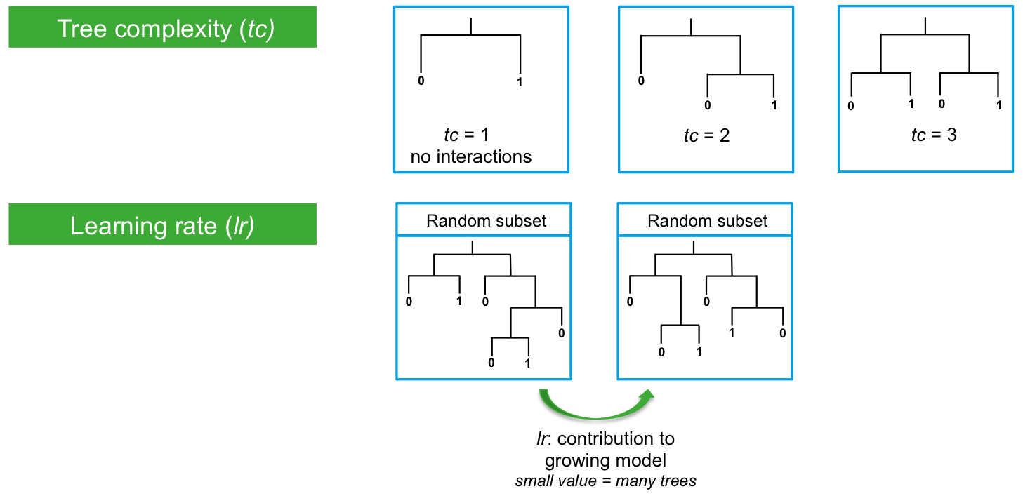
Boosted regression trees (BRT) What Do I Need to specify IT?
How many branches per Small trees
How much information is gained by each subsequent tree

Slide 46
Boosted regression trees (BRT) using the gbm.step function
Basic implementation via the gbm package
gbm.step(data, → Data.frame with all the data
gbm.x, → Indices or names of predictor variables
gbm.y, → Indices or names of the response variable
family, → Type of response [Bernoulli / Poisson / Gaussian]
tree.complexity, → number of splits in each tree
learning.rate, → contribution of each tree to the growing mode
bag.fraction) → proportion of observations used
Some advanced arguments
n.folds → Number of cross validations to be done – 10 by default
prev.stratify → Balance the state of each predictor for each sate of the response.
Only active for presence/absence data.
prev.stratify → Balance the state of each predictor for each sate of the response.
n.trees → Number trees to be used

Slide 47
Boosted regression trees (BRT) Variable importance
Once you have build the “best” model, you would like to know understand the variables that have the largest influence on the response variable.
You can extract this by using either
The summary function on a a gbm.step crated object [this also prints a plot of variance importance]
The subscript contributions in a gbm.step crated object

Slide 48
Boosted regression trees (BRT) Variable importance
> summary(angaus.tc5.lr01,las=2)
var rel.inf
SegSumT SegSumT 26.833196
USNative USNative 13.628545
LocSed LocSed 11.702216
Method Method 9.472981
USAvgT USAvgT 7.320455
DSMaxSlope DSMaxSlope 6.299540
DSDist DSDist 6.252498
SegLowFlow SegLowFlow 5.620587
SegTSeas SegTSeas 5.099794
USRainDays USRainDays 4.079246
USSlope USSlope 3.690943
DSDam DSDam 0.000000
This predictor has no influence

Slide 49
So far so good?
Any questions?
Ready to finish?

Slide 50
In summary…
Classification and Regression trees (CART) provides tool to recursive partitioning of a response variable under the control of a set of explanatory variables.
Classification trees → a categorical response.
Regression trees → a quantitative response.
The goal is to create sequential partitions that minimize a measure of purity of the classification

Slide 51
In summary…
The focus of is producing the best prediction (measured by node purity); and to optimize these CART can be combined with
Bagging Techniques → Random forests
Boosting techniques → Boosted regression trees
… to provide a series of predictions that when combined result in a more accurate prediction than that of any individual tree.

